Slide 1
COVID-19 ANALYSIS
Worldwide and canada
Member: xUEDI CAO (x39cao) & Xiaoke Yu (x94yu)

Slide 2
CONTENT
This project focuses on analyzing data of the world pandemic covid-19 from 2 areas:
WORLDWIDE
CANADA

Slide 3
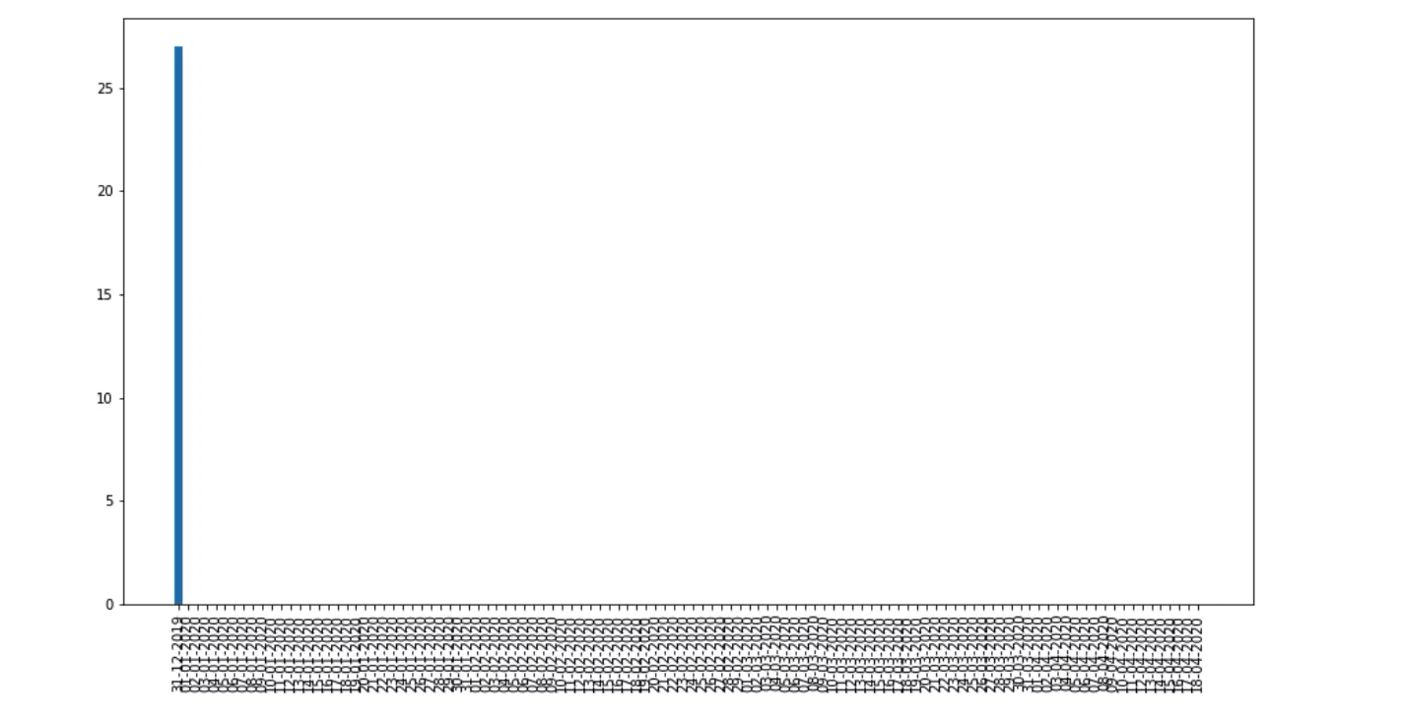
Visualization-World Daily Confirmed Cases (Animated)

Slide 4
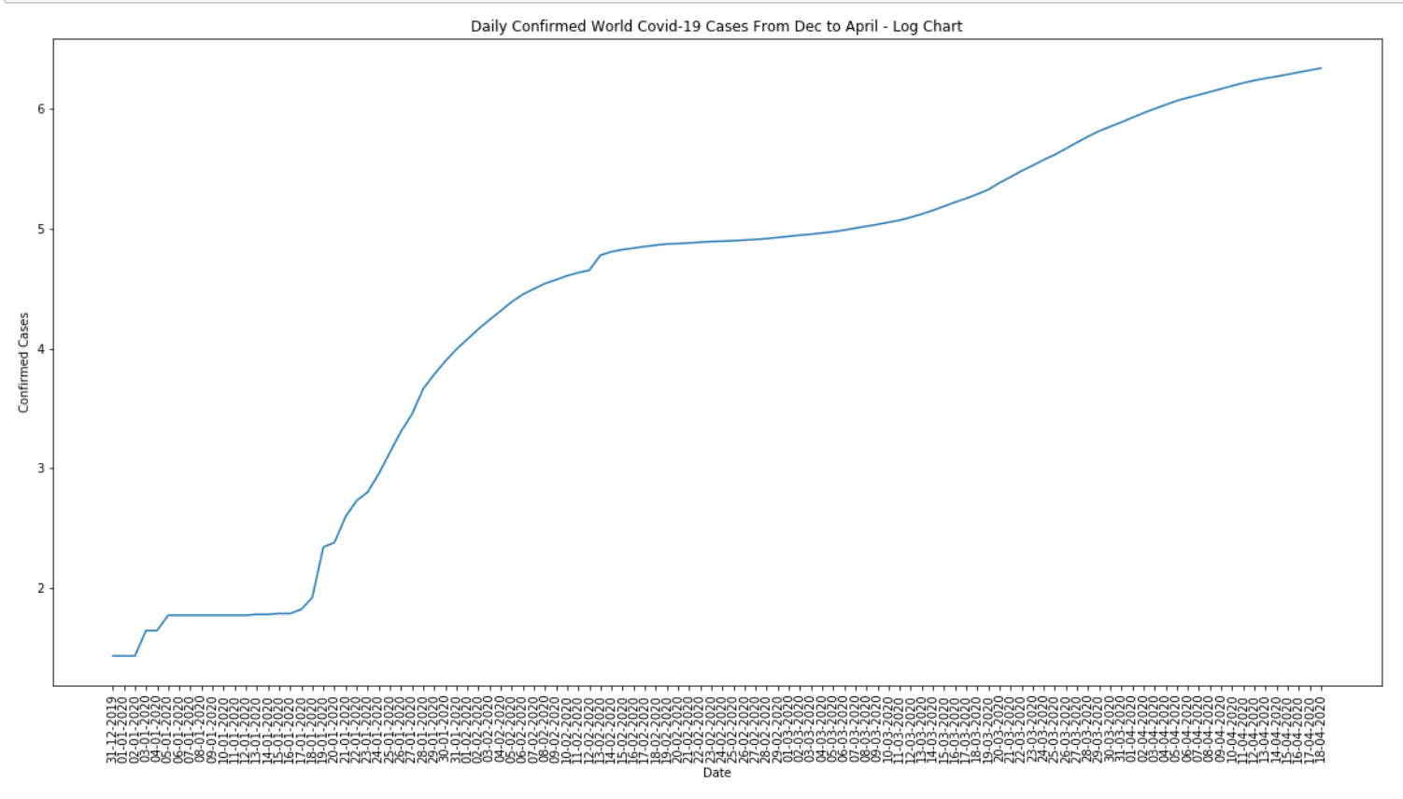
Visualization-World Log Daily Confirmed Cases

Slide 5
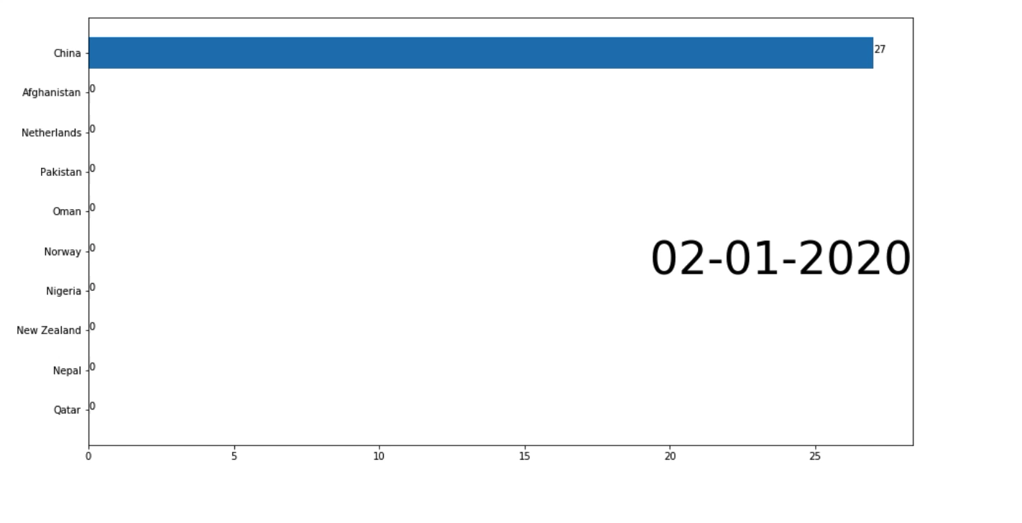
Visualization-World Top 10 Countries with Most Confirmed Cases (Animated)

Slide 6
Prediction-Basic Algorithm
1. The model is based on: Basic reproductive number (R0), Case-fatality Rate (F),
Incubation Period (i), Duration of Disease (d)
2. Idea:
Every Incubation Period, the Predicted Incident Cases increases by R0
From Day0, after duration of disease, the increase of Incident Cases will be 0
Meanwhile, at each duration of disease period, rate of new deaths will increase by F

Slide 7
Prediction-Results (with R0 = 3.28, F = 5%, d = 17 days, I = 14 days)
This model has predicted 100 days of spread of covid-19 among the world:
……. (Omit 22 columns)
Day | Predicted Incident Cases | Predicted Total Cases | Predicted New Deaths | Predicted Total Deaths
0 | 1.0 | 1.0 | 0 | 0
5 | 2.2 | 3.2 | 0 | 0
10 | 4.84 | 8.04 | 0 | 0
15 | 10.65 | 18.69 | 0 | 0
17 | 0 | 18.69 | 0.05 | 0.05
20 | 23.43 | 42.11 | 0.05 | 0.05
22 | 0 | 42.11 | 0.11 | 0.16

Slide 8
Prediction-Results (with R0 = 2.2, F = 5%, d = 17 days, i = 5 days)
This model has predicted 100 days of spread of covid-19 among the world:
……
Day | Predicted Incident Cases | Predicted Total Cases | Predicted New Deaths | Predicted Total Deaths
85 | 662,499.53 | 1,214,581.64, | 1,414.05 | 2,592.38
87 | 0 | 1,214,581.64 | 3,110.91 | 5,703.29
90 | 1,457,498.96 | 2,672,080.6 | 3,110.91 | 5,703.29
92 | 0 | 2,672,080.6 | 6,844.0 | 1,2547.3
95 | 3,206,497.72 | 5,878,578.32 | 6,844.0 | 1,2547.3
97 | 0 | 5,878,578.32 | 15,056.81 | 27,604.11
100 | 7,054,294.99 | 12,932,873.31 | 15,056.81 | 27,604.11

Slide 9

Data source
World Data: https://ourworldindata.org/coronavirus

